Slide 1

ALY 6980 Capstone
Group: Jiacheng Lu, Hongmo Ji, Fangfei Liu

Slide 2
Proposal
In this capstone, we are going to create a deep product analysis and marketing research tool for thousands of products of NorCal Cannabis, which will help them to consolidate cannabis ecommerce data from publicly available sources. We will implement NLP techniques, specifically Spacy package and some text cleaning techniques to deal the word configuration, as well as Kmodes unsupervised learning to find similar clusters for their variety of products since we don’t have a targeted value and the data are all categorical data.

Slide 3

NorCal Cannabis Background
Founded in 2015
Aims to build a cannabis ecosystem
Raised $27.4 million in 2019
Operates production facilities with 100,000 sqft of indoor flower canopy

Slide 4
Business Question & Implementation Strategies

Slide 5
Business Question
Our team serves as the problem-solver for NorCal Cannabis specifically in creating a market research tool that helps the company consolidate cannabis e-commerce data that was collected from publicly available sources.
The main question we are going to focus on are:
1. What is the total number of individual products in this list?
2. What is the most-commonly occurring Gummy product?
3. What is the most commonly occurring Gummy flavor?
4. What is the most commonly occurring cannabis strain?
5. How can we find similar products?

Slide 6
EDA & Visualization
CAPSTONE

Slide 7
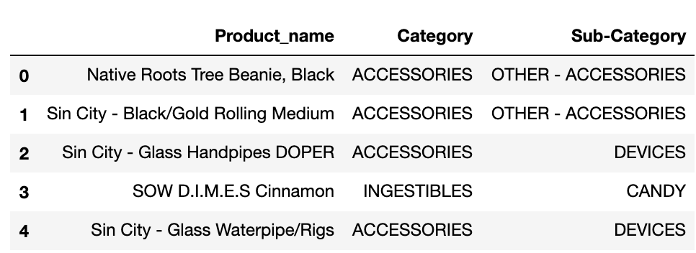
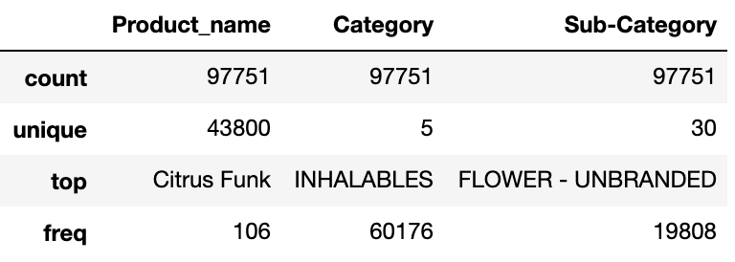
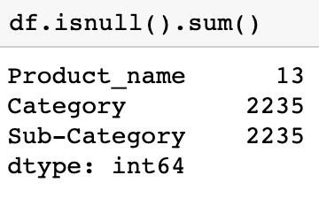
Data preprocessing
This is a relatively clean dataset with three categorical features and 100,000 datapoint with 2235 missing value. There are 43800 unique products in total as showed. We will discard and drop all the missing value to keep the accuracy of the original data.

Slide 8
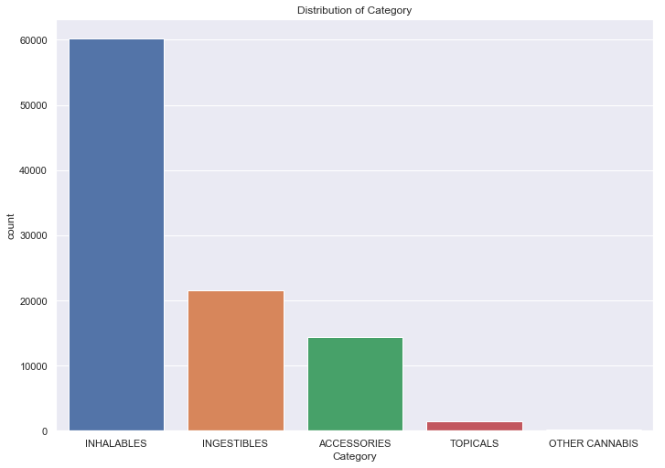
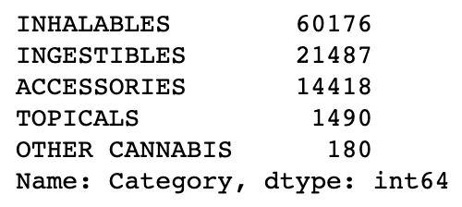
Visualization-
Category

Slide 9
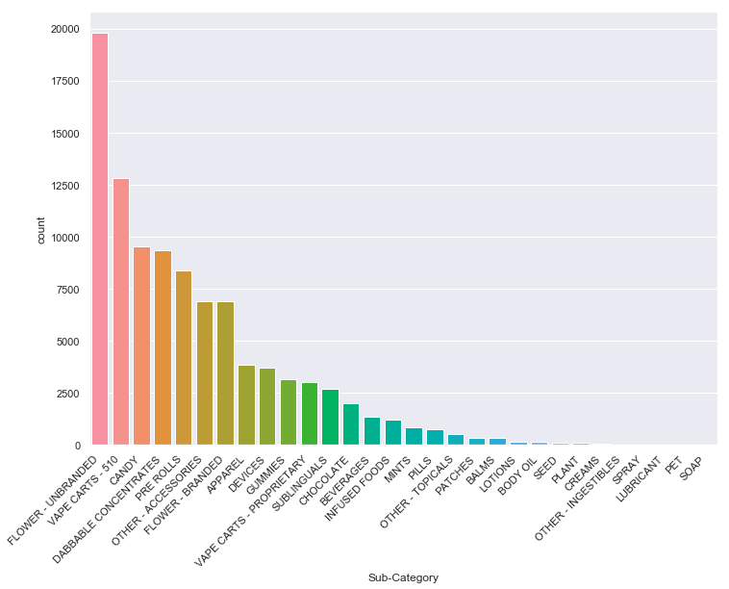
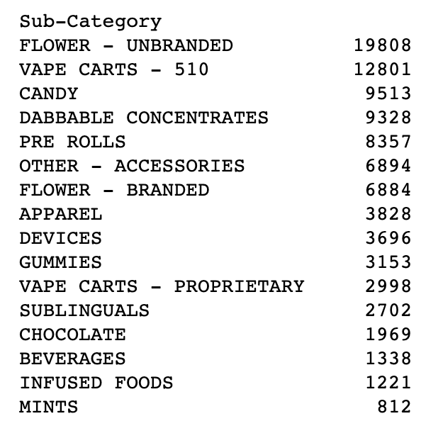
Visualization
Sub-Category
DDDDD

Slide 10
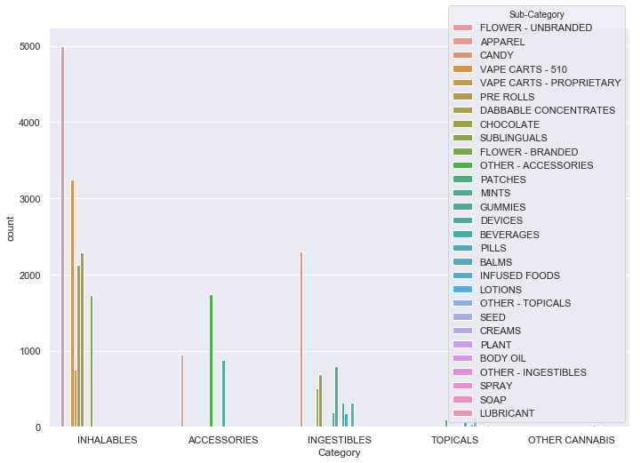
Category VS
Sub-category

Slide 11
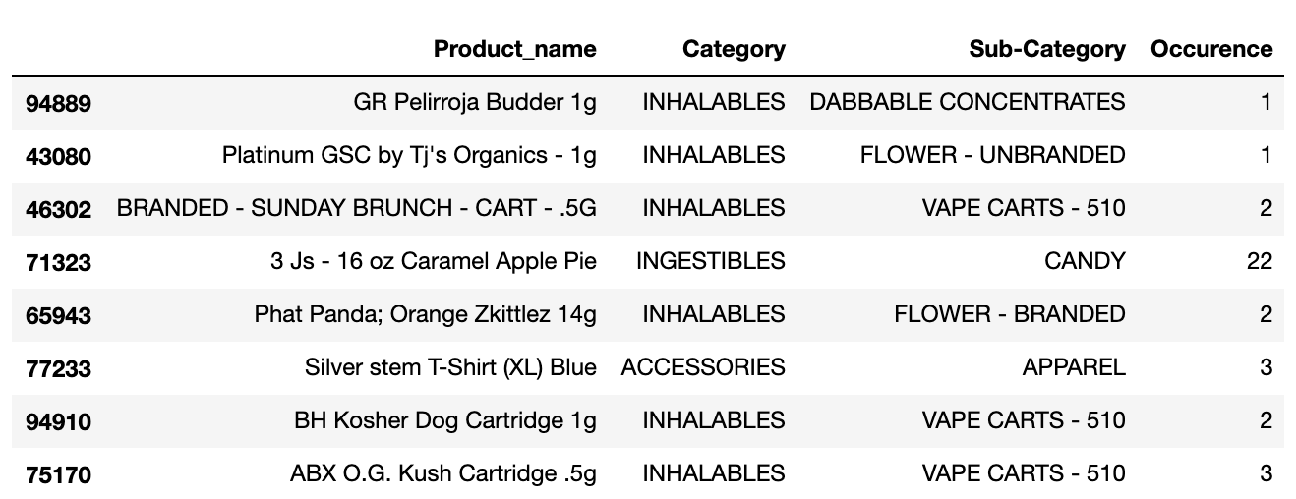
Creating a new feature-Occurrence
For simplicity to find the occurence of each product, we decided to create a new feature by counting each product’s appearance across the dataset. We used left join function to connect the new dataframe with counting information with original data by using product_name.

Slide 12
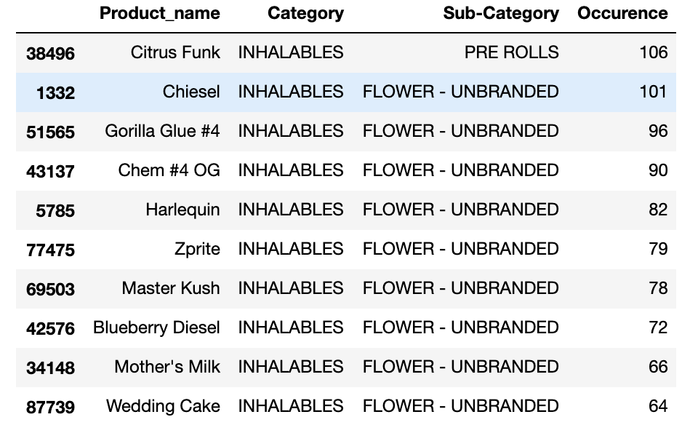
Top 10 Products
Citrus
Chiesel
Gorilla Glue#4
Chem#4
Harlequin
Zprite

Slide 13
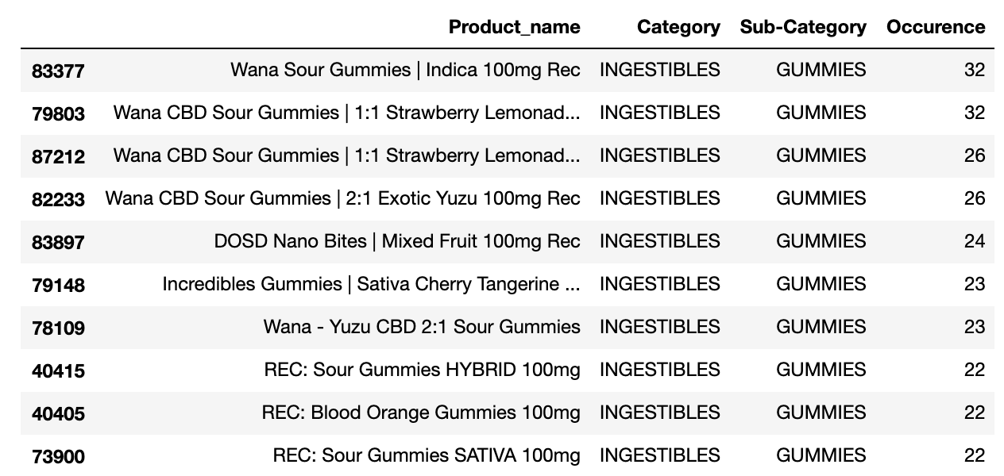
Top 10 Gummy Products

Slide 14
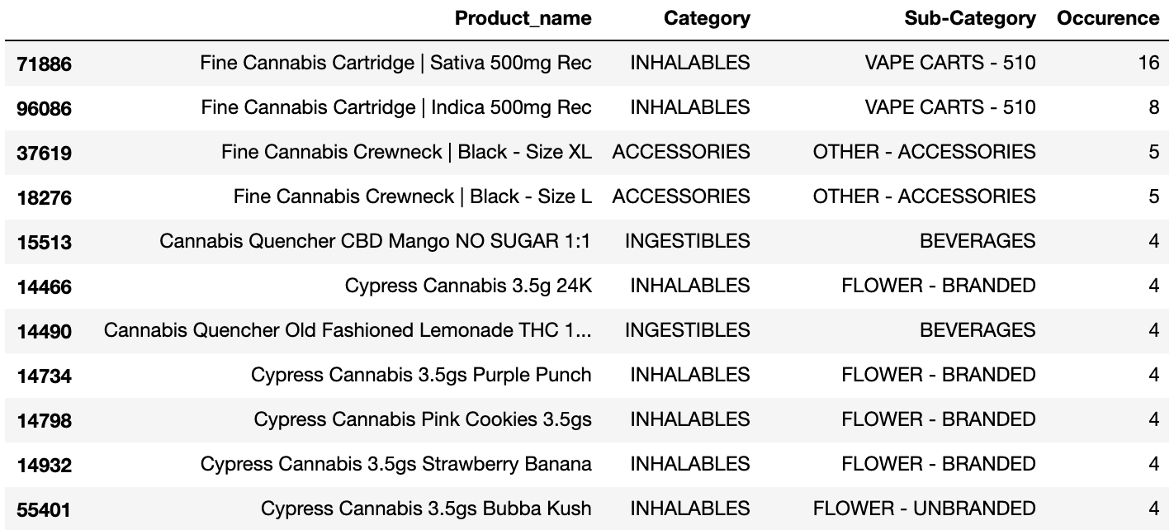
Top 10 Cannabis strain Products
Cannabis strain includes: Sativa, Indica, CBD, Hybrid (Indica dominant, Sativa dominant)

Slide 15
Consumer’s Favorite Gummy Flavor
1
2
3
4
Created a variable to store all the gummy product name
Imported ”re” package to do text cleaning, at the same time saving all the word regarding flavor
Using ’Spacy’ package make text into tokens
Creating frequency word counting functions and generate new data frame of each word occurrence

Slide 16
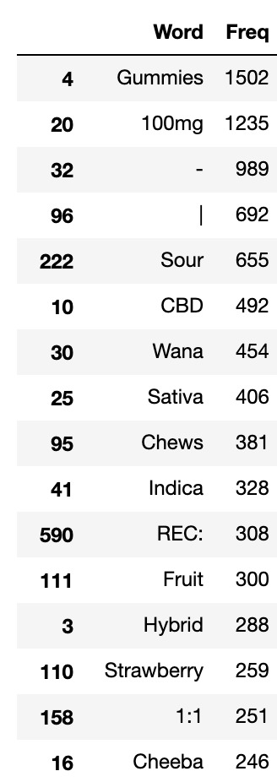
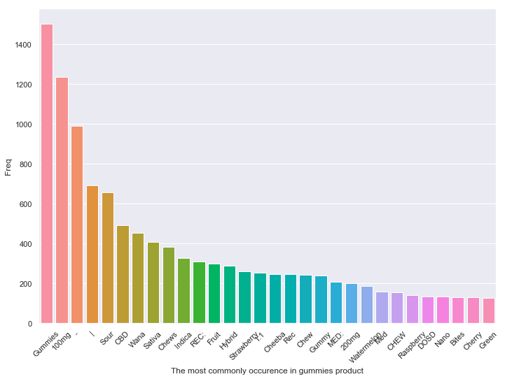

Slide 17
Machine Learning- Kmodes Implementation Strategies

Slide 18
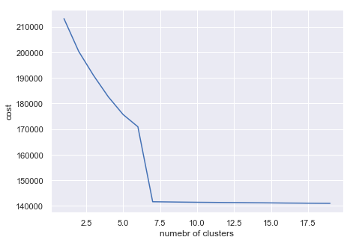
Finding similar products using Kmode clustering
We have recorded the cost when having different number of clusters, such as range from 1 to 20 clusters. The elbow method on the right shows after 7.5, the cost will drop dramatically.
Thus we take 8 as our optimal number of clustering.

Slide 19
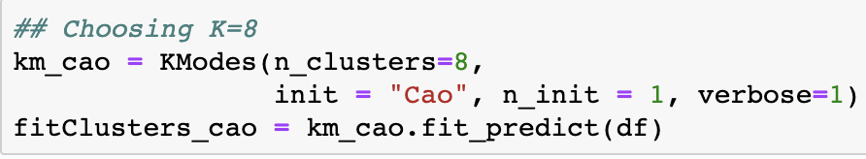
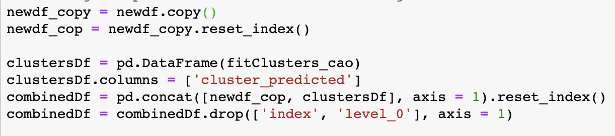
Finding similar products using Kmode clustering
Initiating Kmode cluster prediction:
Combining the predicted clusters with the original data frame.

Slide 20
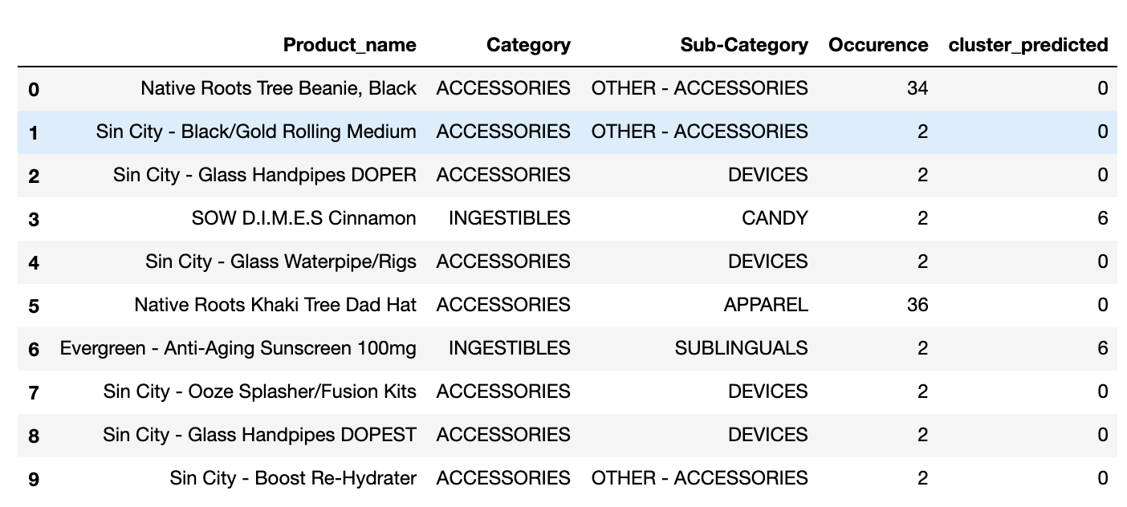
Deliverable result
Week1&week2
Introduction to Capstone and Research.
Overview the dataset
Discussion what to do and make a draft proposal
Week3&week4
Based on the draft and we will add more things
Business question
Some specific strategies to deal with data
Team resource allocation
Timelines

Slide 21
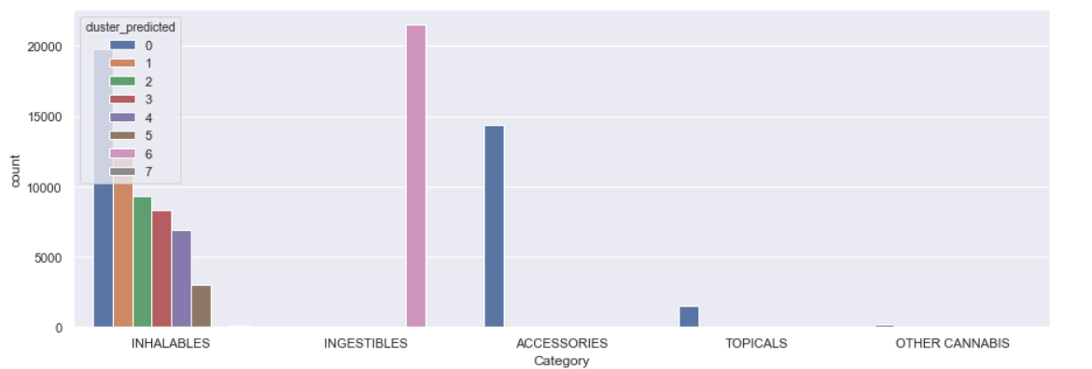

Slide 22
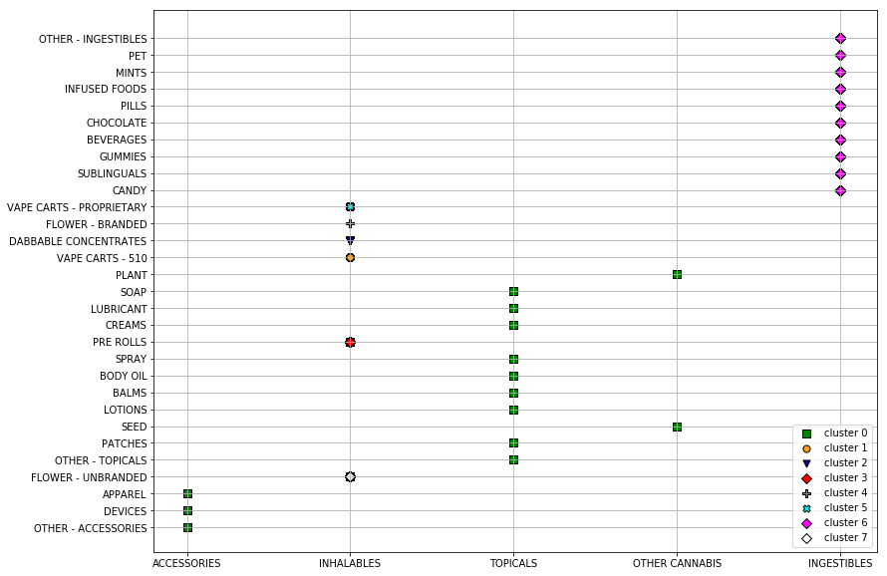

Slide 23
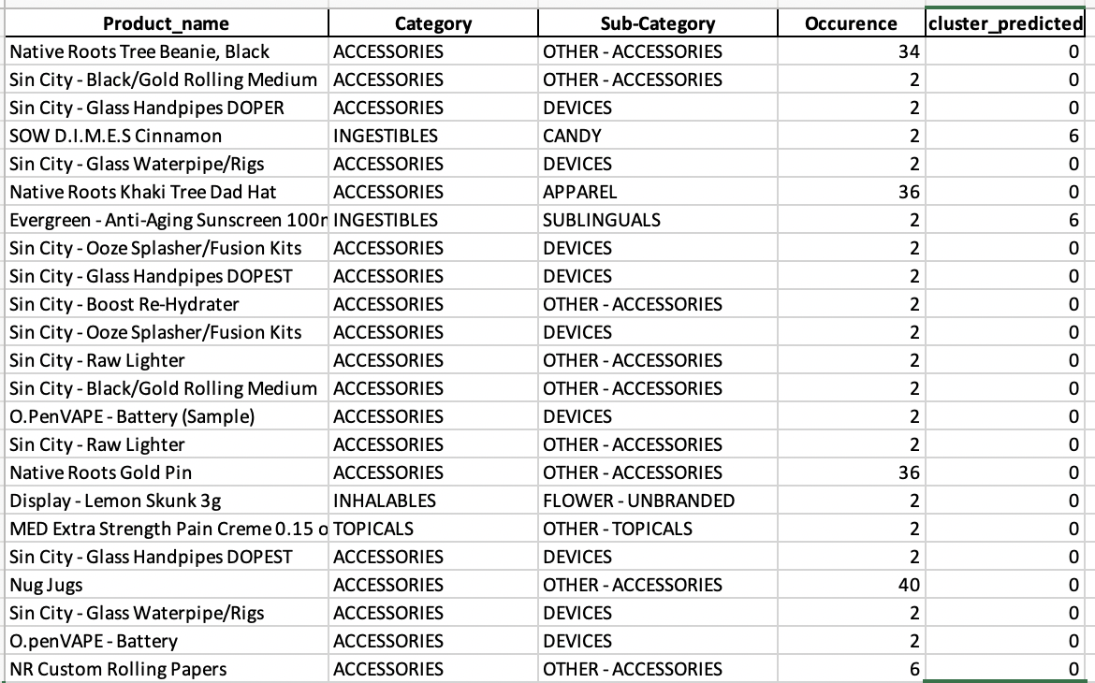
Updated excel sheet

Slide 24
Conclusion:
There are 43,800 unique products in the dataset, which have been divided by 5 category and 30 sub-category.
The most single popular product called citrus funk under inhalable category and flower-unbranded sub-category. The most single popular category is Inhalable product which contains more than half of all products. The most popular sub-category is flower-unbranded.
The most occuring Gummy product is wana sour gummy 100mg. The most commonly occuring gummy flavor is fruit, followed by strawberry, watermelon and so on.
The most commonly occurring cannabis strain is cbd.
All products can be divided by 8 groups based on and category and subcategory.

